Slide 1

Application: PATIENT PORTAL Type: Application Architecture View: Logical View Style: Layered Architecture Pattern
Users
Delivery Channels
Core Business Processes
Data And Information
Technology Enablers
User registration and authentication
Patient data
Payment Gateways
DOCTORS
Doctors data
Patient dashboard
Web Browser
Appointment data
API integration
Doctors Dashboard
PATIENTS
Medical records
Data base management systems (DBMS)
Diagnostic Reports
Payment information
Payment
Cloud Services (AWS )
Web Browser
Communication data
Github & Delivery Pipeline
Advertisement
Feedback
Administrator

Slide 2
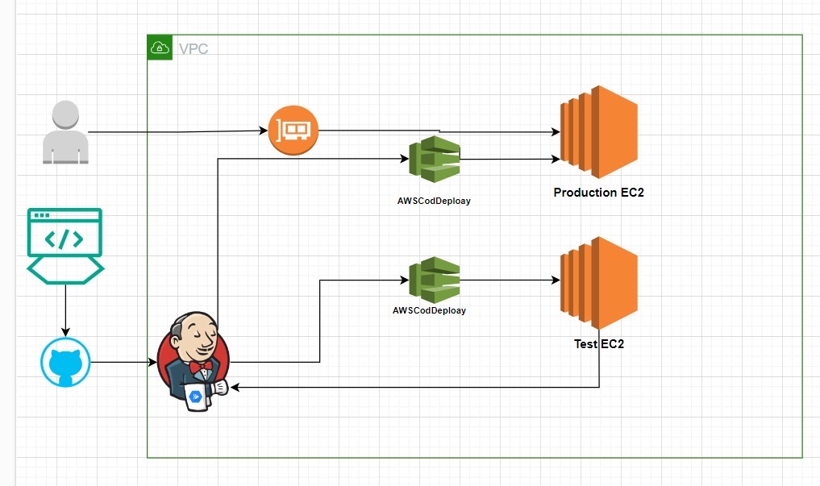
Application: PATIENT PORTAL Type: Application Architecture View: Process View

